Slide 1
Hyperledger

Slide 2
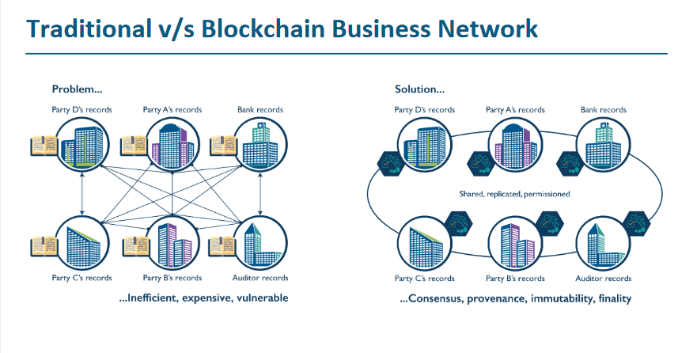

Slide 3
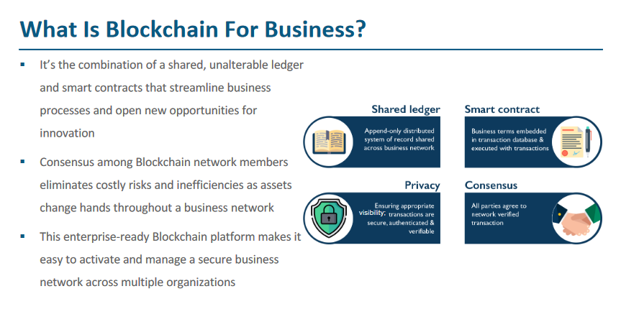

Slide 4
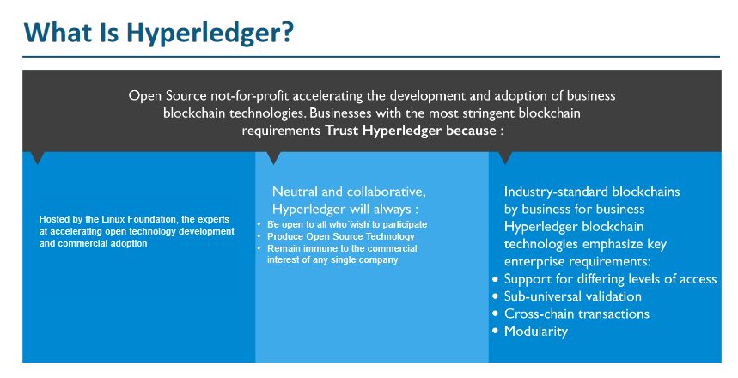

Slide 5
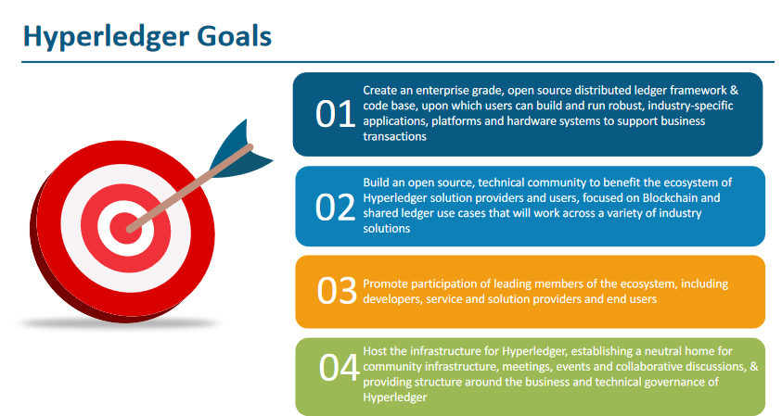

Slide 6
Hyperledger Projects : Assignment

Slide 7
Hyperledger Fabric

Slide 8
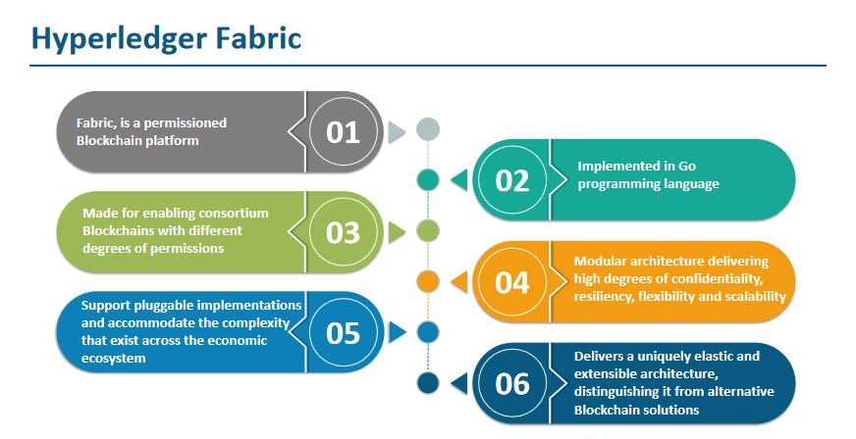

Slide 9










































Actors

Slide 10




























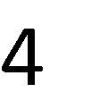

Slide 11































Components

Slide 12
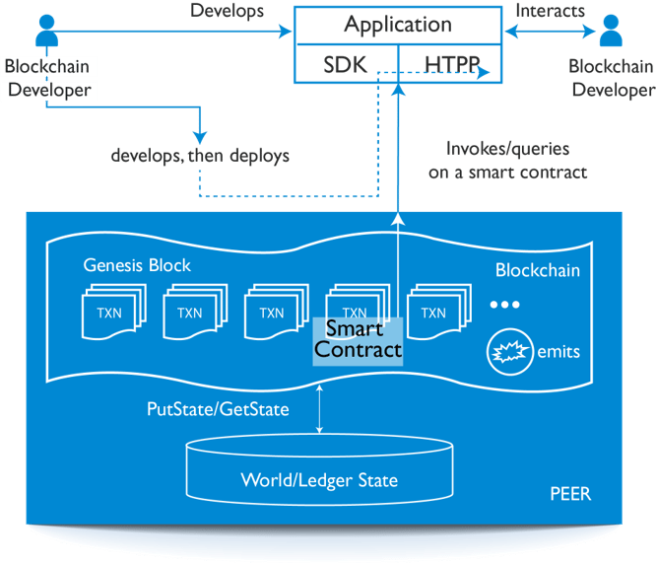
Architecture:

Slide 13


















Ledger consists of:

Slide 14



Nodes and their Rolesdes and Roles
 | Committing Peer: Maintains ledger and state. Commits transactions. May hold smart contract (chaincode).
 | Endorsing Peer: Specialized committing peer that receives a transaction proposal for endorsement, responds granting or denying endorsement. Must hold smart contract
 | Ordering Node: Approves the inclusion of transaction blocks into the ledger and communicates with committing and endorsing peer nodes. Does not hold smart contract. Does not hold ledger.

Slide 15


















Architecture Fabric V1 Architecture
External-CA
Fabric-CA
Membership
Services
✓
optional
optional
✓
Admin
Peer
Endorser
Client Application
SDK (HFC)
Committer
O O
Ledger Chaincode Events
A
B
O O
Ordering-Service
!
Hyperledger Fabric Network

Slide 16






Transaction Flow Flow
Consensus is achieved using the following transaction flow:
Endorse
Order
Validate

Slide 17





























Step 1/7: Propose Transaction Propose Transaction
Application proposes transaction
E₀ P₃ P₄
Endorsement policy:
“E_{0,} E₁ and E₂ must sign”
A A
B D
(P , P are not part of the policy)
3 4
E₁
Client application submits a transaction proposal for Smart Contract A. It must
Client Application
S D K
O
O
target the required peers {E E E }
A
B
0 1 2
Key:
Endorser |  |  | Ledger
Committing Peer |  |  | Application
Ordering Node
Smart Contract (Chaincode) |  |  | Endorsement Policy
E₂
P
O O
Ordering-Service
A
B
Hyperledger Fabric Network

Slide 18



























Step 2/7: Execute Proposed Transaction
Endorsers Execute Proposals
E₀ P₃ P₄
E₀, E₁ & E₂ will each execute the proposed transaction. None of these executions will update the ledger
Each execution will capture the set of Read and Write data, called RW sets, which will now flow in the fabric.
Transactions can be signed & encrypted
Key:
A A
B D
Client
S D K
E₁
Application
O
O
A
B
Endorser |  |  |  |  | Ledger
Committing Peer |  |  |  |  | Application
Ordering Node
Smart Contract (Chaincode) |  |  |  |  | Endorsement Policy
E₂
P
O O
Ordering-Service
A
B
Hyperledger Fabric Network

Slide 19
















Step 3/7: Proposal Response
Application receives responses
E₀
P₃ P₄
Read-Write sets are asynchronously returned to application
The RW sets are signed by each endorser, and also includes each record version number
(This information will be checked much later in the consensus process)
Key:
A
B
A
D
Client Application
S D K
E₁
O
O
A
B
Endorser |  |  | Ledger
Committing Peer |  |  | Application
Ordering Node
Smart Contract (Chaincode) |  |  | Endorsement Policy
E₂
P
O O
Ordering-Service
A
B
Hyperledger Fabric Network

Slide 20





















Step 4/7: Order Transaction
Responses submitted for ordering
E₀
P₃
P₄
Application submits responses as a transaction to be ordered.
A
B
A
D
E
Ordering happens across the fabric in
Client Application
S D
K
1
parallel with transactions submitted by other applications
O
O
A
B
E
P
O O
Ordering-Service
Key:
2
Endorser |  |  | Ledger
Committing Peer |  |  | Application
Ordering Node
Smart Contract (Chaincode) |  |  | Endorsement Policy
A
B
Hyperledger Fabric Network
(other applications)

Slide 21










Step 5/7: Deliver Transaction
Orderer delivers to committing peers
E₀
P₃ P₄
Ordering service collects transactions into proposed blocks for distribution to committing peers. Peers can deliver to other peers in a hierarchy (not shown) Different ordering algorithms available:
SOLO (Single node, development)
Kafka (Crash fault tolerance)
Key:
A
B
A
D
*
Client Application
S D K
E₁
O
O
A
B
Endorser |  |  |  |  | Ledger
Committing Peer |  |  |  |  | Application
Ordering Node
Smart Contract (Chaincode) |  |  |  |  | Endorsement Policy
E
P
O O
Ordering-Service
2
A
B
Hyperledger Fabric Network

Slide 22























Step 6/7: Validate Transaction
Committing peers validate transactions
E₀ P₃ P₄
Every committing peer validates against the endorsement policy. Also check RW sets are still valid for current world state
Validated transactions are applied to the world state and retained on the ledger
A A
*
B D
* *
Client Application
S D K
E₁
O
O
*
A
B
Key:
Endorser |  |  |  |  | Ledger
Committing Peer |  |  |  |  | Application
Ordering Node
Smart Contract (Chaincode) |  |  |  |  | Endorsement Policy
E
P
O O
Ordering-Service
2
*
A
B
Hyperledger Fabric Network

Slide 23










Step 7/7: Notify Transaction
Committing peers notify applications
!
E₀
P₃ P₄
!
!
Applications can register to be notified when transactions succeed or fail, and when blocks are added to the ledger
A
B
A
D
E₁
Applications will be notified by each peer to which they are connected
Client Application
S
D !
K
!
O
O
A
B
Key:
Endorser |  |  | Ledger
Committing Peer |  |  | Application
Ordering Node
Smart Contract (Chaincode) |  |  | Endorsement Policy
E₂
P
O O
Ordering-Service
!
A
B
Hyperledger Fabric Network

Slide 24




Ordering Service
The ordering service packages transactions into blocks to be delivered to peers. Communication with the service is via channels.
Different configuration options for the ordering service include:
SOLO
Single node for development
Kafka : Crash fault tolerant consensus
3 nodes minimum
Odd number of nodes recommended
O
O
O O
Ordering-Service

Slide 25









Channels
Channels provide privacy between different ledgers
Ledgers exist in the scope of a channel
Channels can be shared across an entire network of peers
Channels can be permissioned for a specific set of participants
Chaincode is installed on peers to access the worldstate
Peers can participate in multiple channels
Concurrent execution for performance and scalability
E
O
O
0
O O
Ordering-Service
E₁

Slide 26





























Single Channel Network
All peers connect to the same system channel (blue).
All peers have the same chaincode and maintain the same ledger
Client Application
S D
K
E₀
A
E₂
A
B
O
O
B
Endorsement by peers E E E and E
0, 1, 2 3
P
O O _{E}
Ordering-Service
A
B
E
Key:
1
3
Endorser |  |  | Ledger
Committing Peer |  |  | Application
Ordering Node
Smart Contract (Chaincode) |  |  | Endorsement Policy
A
B
Hyperledger Fabric Network

Slide 27




























Multi-Channel Network
Peers E₀ and E₃ connect to the red channel for chaincodes Y and Z
Client Application
S D
K
E
E
0
2
O
O
Peers E₁ and E₂ connect to the blue channel for chaincodes A and B
Y
Z
B
A
P
P
O O
Ordering-Service
Client Application
S D
K
E
E₃
Key:
1
Endorser |  |  |  |  | Ledger
Committing Peer |  |  |  |  | Application
Ordering Node
Smart Contract (Chaincode) |  |  |  |  | Endorsement Policy
A
B
Z
Y
Hyperledger Fabric Network

Slide 28











Fabric Peer
A
– Each peer:
Connects to one or more channels
Maintains one or more ledgers for each channel
Chaincodes are shared across channels (no state is stored in chaincode container)
Local MSP (Membership Services Provider) provides crypto material
Emits events to the client application
Peer
Chaincode
Channels
B
Events !
Local
MSP
0
1
2
3
Ledger
Blockchain
WorldState

